Slide 1
The Fruit of the Spirit
Self-control

Slide 2
Control
Power to dominate, influence
Under control
Out of control
Self-control
Acts 24:24-25 But after certain days, Felix came with Drusilla, his wife, who was a Jewess, and sent for Paul, and heard him concerning the faith in Christ Jesus. 25 And as he reasoned of righteousness, and self-control, and the judgment to come, Felix was terrified, and answered, Go thy way for this time; and when I have a convenient season, I will call thee unto me.
2 Peter 1:5-7 Yea, and for this very cause adding on your part all diligence, in your faith supply virtue; and in your virtue knowledge; 6 and in your knowledge self-control; and in your self-control patience; and in your patience godliness; 7 and in your godliness brotherly kindness; and in your brotherly kindness love.

Slide 3
Galatians 5:22-23 But the fruit of the Spirit is love, joy, peace, longsuffering, kindness, goodness, faithfulness, 23 meekness, self-control; against such there is no law.
Love
Peace
Kindness
Faithfulness
Joy
Longsuffering
Goodness
Meekness
Self-control

Slide 4
Walking By the Spirit
Galatians 5:16-25 But I say, walk by the Spirit, and ye shall not fulfil the lust of the flesh.
17 For the flesh lusteth against the Spirit, and the Spirit against the flesh; for these are contrary the one to the other; that ye may not do the things that ye would.
18 But if ye are led by the Spirit, ye are not under the law.
19 Now the works of the flesh are manifest, which are these: fornication, uncleanness, lasciviousness,
20 idolatry, sorcery, enmities, strife, jealousies, wraths, factions, divisions, parties,
21 envyings, drunkenness, revellings, and such like; of which I forewarn you, even as I did forewarn you, that they who practise such things shall not inherit the kingdom of God.
22 But the fruit of the Spirit is love, joy, peace, longsuffering, kindness, goodness, faithfulness,
23 meekness, self-control; against such there is no law.
24 And they that are of Christ Jesus have crucified the flesh with the passions and the lusts thereof.
25 If we live by the Spirit, by the Spirit let us also walk.

Slide 5
Galatians 5:19-21
The works of the flesh
1 Peter 4:3-4 For the time past may suffice to have wrought the desire of the Gentiles, and to have walked in lasciviousness, lusts, winebibbings, revellings, carousings, and abominable idolatries: 4 wherein they think strange that ye run not with them into the same excess of riot, speaking evil of you
fornication, uncleanness, lasciviousness, idolatry, sorcery, enmities, strife, jealousies, wraths, factions, divisions, parties, envyings, drunkenness, revellings,
and such like

Slide 6
What rules over you?
Romans 6:8-14 But if we died with Christ, we believe that we shall also live with him;
9 knowing that Christ being raised from the dead dieth no more; death no more hath dominion over him.
10 For the death that he died, he died unto sin once: but the life that he liveth, he liveth unto God.
11 Even so reckon ye also yourselves to be dead unto sin, but alive unto God in Christ Jesus.
12 Let not sin therefore reign in your mortal body, that ye should obey the lusts thereof:
13 neither present your members unto sin as instruments of unrighteousness; but present yourselves unto God, as alive from the dead, and your members as instruments of righteousness unto God.
14 For sin shall not have dominion over you: for ye are not under law, but under grace.

Slide 7
Totally under control
Totally out of control
Momentarily out
of control?
Behaviors:
Drunkedness
Sexual addiction
Drug addiction
anger, wrath
Spiritual Goal:
To bring every thought and every word, deed under control to obey God
To be able to stand face to face with your temptation and deny yourself and wrong doing
How to calculate the damage of just one sin in your life:
Fornication, adultery… just once
Alcohol, drug abuse… just once
Anger, wrath… one occasion
Left unresolved, without repentance, one sin can keep you out of heaven
cf. Moses and the promised land

Slide 8
Is God working in you?
Philippians 2:12-13 So then, my beloved, even as ye have always obeyed, not as in my presence only, but now much more in my absence, work out your own salvation with fear and trembling; 13 for it is God who worketh in you both to will and to work, for his good pleasure.
Ephesians 2:10 For we are his workmanship, created in Christ Jesus for good works, which God afore prepared that we should walk in them.

Slide 9
Strategies to regain control
Romans 13:14 But put ye on the Lord Jesus Christ, and make not provision for the flesh, to fulfil the lusts thereof.
James 5:16 Confess therefore your sins one to another, and pray one for another, that ye may be healed. The supplication of a righteous man availeth much in its working.
Prayer, trust God to deliver you - 1 Corinthians 10:13 There hath no temptation taken you but such as man can bear: but God is faithful, who will not suffer you to be tempted above that ye are able; but will with the temptation make also the way of escape, that ye may be able to endure it.

Slide 10
Holiness
To live with an awareness the God is every present with you and in you is what allows us to be holy. We restrain ourselves from sinful, worldly pursuits in order to not defile ourselves. Just knowing that we individually are a “temple of the Holy Spirit with is in you” helps us to be godly, self-controlled and righteous in the way we live before God.
1 Corinthians 6:18-20 Flee fornication. Every sin that a man doeth is without the body; but he that committeth fornication sinneth against his own body. 19 Or know ye not that your body is a temple of the Holy Spirit which is in you, which ye have from God? and ye are not your own; 20 for ye were bought with a price: glorify God therefore in your body.

Slide 12
Romans 5:14 Nevertheless death reigned
Romans 5:17 much more shall they that receive the abundance of grace and of the gift of righteousness reign in life through the one, even Jesus Christ.
Romans 5:17 death reigned through the one (Adam)
Romans 5:21 that, as sin reigned in death, even so might grace reign through righteousness unto eternal life through Jesus Christ our Lord.
Romans 6:1 What shall we say then? Shall we continue in sin, that grace may abound?
Romans 6:6 knowing this, that our old man was crucified with him, that the body of sin might be done away, that so we should no longer be in bondage to sin
Romans 7:5 For when we were in the flesh, the sinful passions, which were through the law, wrought in our members to bring forth fruit unto death.
Romans 6:12 Let not sin therefore reign in your mortal body, that ye should obey the lusts thereof
Romans 7:23 but I see a different law in my members, warring against the law of my mind, and bringing me into captivity under the law of sin which is in my members.
Romans 6:14 For sin shall not have dominion over you
Romans 6:18 and being made free from sin
Romans 8:2 For the law of the Spirit of life in Christ Jesus made me free from the law of sin and of death.
Romans 6:21 the end of those things is death
Romans 6:22 But now being made free from sin
Romans 8:13 for if ye live after the flesh, ye must die; but if by the Spirit ye put to death the deeds of the body, ye shall live.
Romans 6:23 For the wages of sin is death

Slide 13
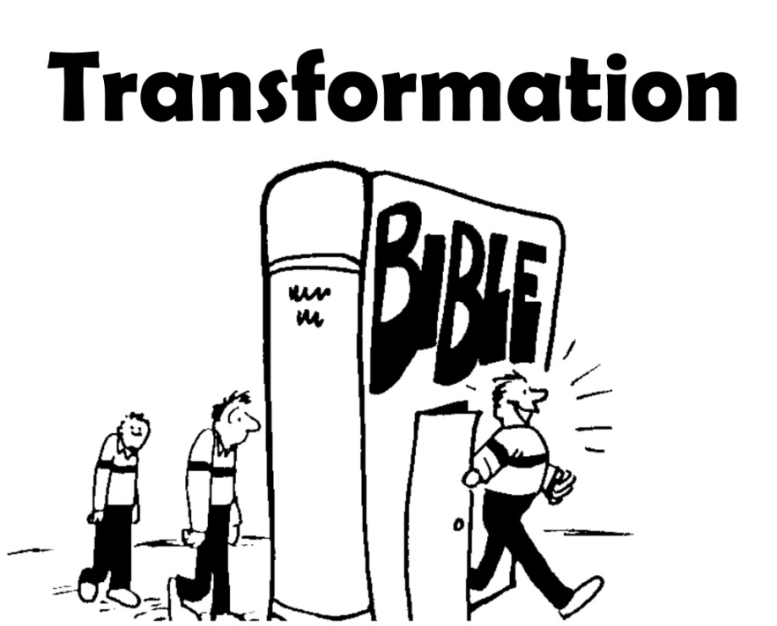
Romans 6:1 What shall we say then? Shall we continue in sin, that grace may abound?
Romans 6:3-4 Or are ye ignorant that all we who were baptized into Christ Jesus were baptized into his death? 4 We were buried therefore with him through baptism unto death: that like as Christ was raised from the dead through the glory of the Father, so we also might walk in newness of life.
Romans 6:6 knowing this, that our old man was crucified with him, that the body of sin might be done away, that so we should no longer be in bondage to sin
Romans 6:12 Let not sin therefore reign in your mortal body, that ye should obey the lusts thereof
Romans 6:14 For sin shall not have dominion over you
Romans 6:18 and being made free from sin
Romans 6:21 the end of those things is death
Romans 6:22 But now being made free from sin
Romans 6:23 For the wages of sin is death

Slide 14
Matthew 5:28 but I say unto you, that every one that looketh on a woman to lust after her hath committed adultery with her already in his heart.
Romans 1:24 Wherefore God gave them up in the lusts of their hearts unto uncleanness, that their bodies should be dishonored among themselves:
Mark 4:19 and the cares of the world, and the deceitfulness of riches, and the lusts of other things entering in, choke the word, and it becometh unfruitful.
Romans 1:27 and likewise also the men, leaving the natural use of the woman, burned in their lust one toward another, men with men working unseemliness, and receiving in themselves that recompense of their error which was due.
John 8:44 Ye are of your father the devil, and the lusts of your father it is your will to do…
Romans 6:12 Let not sin therefore reign in your mortal body, that ye should obey the lusts thereof:
Romans 13:14 But put ye on the Lord Jesus Christ, and make not provision for the flesh, to fulfil the lusts thereof.

Slide 15
Galatians 5:16 But I say, walk by the Spirit, and ye shall not fulfil the lust of the flesh.
Galatians 5:17 For the flesh lusteth against the Spirit, and the Spirit against the flesh; for these are contrary the one to the other; that ye may not do the things that ye would.
Galatians 5:24 And they that are of Christ Jesus have crucified the flesh with the passions and the lusts thereof.
James 4:1-3 Whence come wars and whence come fightings among you? come they not hence, even of your pleasures that war in your members? 2 Ye lust, and have not: ye kill, and covet, and cannot obtain: ye fight and war; ye have not, because ye ask not. 3 Ye ask, and receive not, because ye ask amiss, that ye may spend it in your pleasures.
2 Corinthians 10:3-5 For though we walk in the flesh, we do not war according to the flesh 4 (for the weapons of our warfare are not of the flesh, but mighty before God to the casting down of strongholds), 5 casting down imaginations, and every high thing that is exalted against the knowledge of God, and bringing every thought into captivity to the obedience of Christ;
Titus 2:12 instructing us, to the intent that, denying ungodliness and worldly lusts, we should live soberly and righteously and godly in this present world
2 Corinthians 7:1 Having therefore these promises, beloved, let us cleanse ourselves from all defilement of flesh and spirit, perfecting holiness in the fear of God.

Slide 16
1 Peter 1:14 as children of obedience, not fashioning yourselves according to your former lusts in the time of your ignorance:
2 Peter 2:18 For, uttering great swelling words of vanity, they entice in the lusts of the flesh, by lasciviousness, those who are just escaping from them that live in error;
1 Peter 2:11 Beloved, I beseech you as sojourners and pilgrims, to abstain from fleshly lust, which war against the soul;
2 Peter 3:3 knowing this first, that in the last days mockers shall come with mockery, walking after their own lusts
1 Peter 4:2 that ye no longer should live the rest of your time in flesh to the lusts of men, but to the will of God.
1 John 2:16-17 For all that is in the world, the lust of the flesh and the lust of the eyes and the vain glory of life, is not of the Father, but is of the world. 17 And the world passeth away, and the lust thereof: but he that doeth the will of God abideth for ever.
2 Peter 1:4 whereby he hath granted unto us his precious and exceeding great promises; that through these ye may become partakers of the divine nature, having escaped from the corruption that is in that world by lust.
Jude 1:16 These are murmurers, complainers, walking after their lusts (and their mouth speaketh great swelling words), showing respect of persons for the sake of advantage.
Jude 1:18 That they said to you, In the last time there shall be mockers, walking after their own ungodly lusts.
2 Peter 2:10 but chiefly them that walk after the flesh in the lust of defilement, and despise dominion. Daring, self-willed, they tremble not to rail at dignities:

Slide 17
Romans 7:24 Wretched man that I am! who shall deliver me out of the body of this death?
Romans 8:9
But ye are not in the flesh but in the Spirit, if so be that the Spirit of God dwelleth in you. But if any man hath not the Spirit of Christ, he is none of his.
Matthew 16:24 Then said Jesus unto his disciples, If any man would come after me,
let him deny himself,
and take up his cross,
and follow me.
LOVE
Romans 8:22-23 For we know that the whole creation groaneth and travaileth in pain together until now. 23 And not only so, but ourselves also, who have the first-fruits of the Spirit, even we ourselves groan within ourselves, waiting for our adoption, to wit, the redemption of our body.

Slide 18
For the law of the Spirit of life in Christ Jesus | the law of sin and of death.
Who walk after the Spirit | who walk not after the flesh
they that are after the Spirit mind the things of the Spirit | they that are after the flesh mind the things of the flesh
the mind of the Spirit is life and peace | the mind of the flesh is death
 | the mind of the flesh is enmity against God
 | for it is not subject to the law of God, neither indeed can it be
 | they that are in the flesh cannot please God
Galatians 5:16 But I say, walk by the Spirit, and ye shall not fulfil the lust of the flesh.

Slide 19
Romans 8
9 But ye are not in the flesh but in the Spirit, if so be that the Spirit of God dwelleth in you. But if any man hath not the Spirit of Christ, he is none of his.
10 And if Christ is in you, the body is dead because of sin; but the spirit is life because of righteousness.
11 But if the Spirit of him that raised up Jesus from the dead dwelleth in you, he that raised up Christ Jesus from the dead shall give life also to your mortal bodies through his Spirit that dwelleth in you.
1 Corinthians 6:19-20
Or know ye not that your body is a temple of the Holy Spirit which is in you, which ye have from God? and ye are not your own; 20 for ye were bought with a price: glorify God therefore in your body.
Galatians 5:16 But I say, walk by the Spirit, and ye shall not fulfil the lust of the flesh.
Romans 8:14 For as many as are led by the Spirit of God, these are sons of God.
Romans 8:12-13 So then, brethren, we are debtors, not to the flesh, to live after the flesh: 13 for if ye live after the flesh, ye must die; but if by the Spirit ye put to death the deeds of the body, ye shall live.

Slide 20
Walking In the Spirit
Ephesians 2
1. And you did he make alive, when ye were dead through your trepasses and sins,
2. wherein ye once walked according to the course of this world, according to the prince of the powers of the air, of the spirit that now worketh in the sons of disobedience;
3. among whom we also all once lived in the lust of our flesh, doing the desires of the flesh and of the mind, and were by nature children of wrath, even as the rest:--
Romans 6
6. knowing this, that our old man was crucified with him, that the body of sin might be done away, that so we should no longer be in bondage to sin;
7. for he that hath died is justified from sin.
8. But if we died with Christ, we believe that we shall also live with him;
9. knowing that Christ being raised from the dead dieth no more; death no more hath dominion over him.
10. For the death that he died, he died unto sin once: but the life that he liveth, he liveth unto God.
11. Even so reckon ye also yourselves to be dead unto sin, but alive unto God in Christ Jesus.
12. Let not sin therefore reign in your mortal body, that ye should obey the lusts thereof:

